Slide 1
Kick-off meeting Embedded Control Project (ECP)
Jörg Fischer
Systems Control and Optimization Laboratory
Department of Microsystems Engineering
University of Freiburg
www.syscop.de

Slide 2
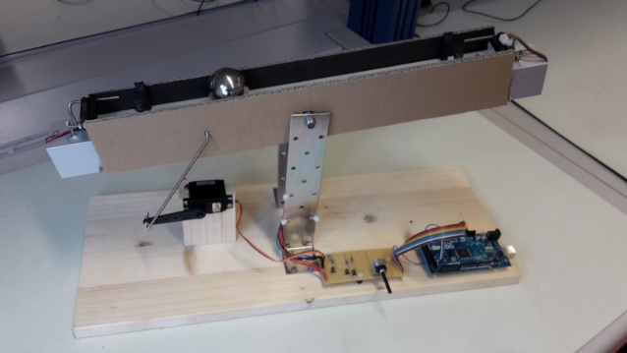
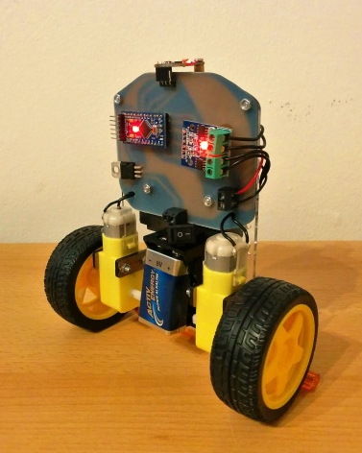
Agenda
Introduction
Teams and supervision
Prosepective control setups
Formalities
Getting started

Slide 3
Agenda
Introduction (2 Slides)
Teams and supervision
Prosepective control setups
Formalities
Getting started

Slide 4
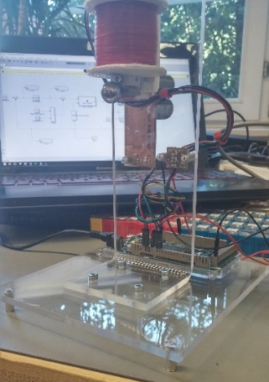
Introduction - ECP
What is the task? In groups of three, develop a cool control system setup including
idea and project plan
hardware (mechanics & electronics)
software (MATLAB/Simulink, C)
(model-based) controller
putting all into operation
Why?
It is fun and you gain practical experience in designing control systems
The developed setups shall be used in
lectures to demonstrate control applications / methods
a future practical course to let students experience how to implement, tune, and use different control methods

Slide 5
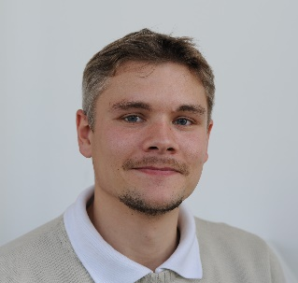
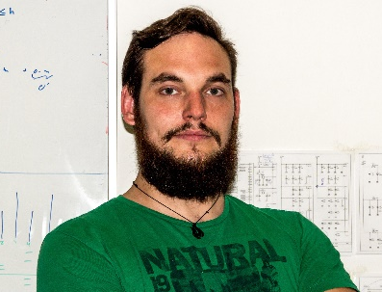
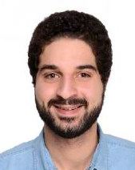
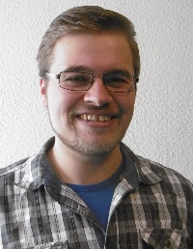
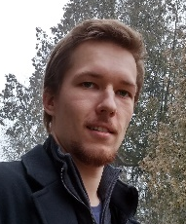
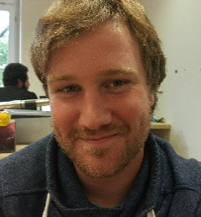
Introduction - Tutors
Jörg Fischer (joerg.fischer@imtek.de)
Thorbjörn Jörger
(thorbina@imtek.de)
Louay Abdelgawad
(lo2aayyguc@gmail.com)
Paul Daum (paul.daum@jupiter.uni-freiburg.de)
Nicholas Feix (feixn@tf.uni-freiburg.de)
Peter Hofmeier
(phofmeier@googlemail.com)

Slide 6
Agenda
Introduction
Teams and supervision (1 Slide)
Prosepective control setups
Formalities
Getting started

Slide 7
Teams and supervision
List of teams
Supervision
Every team has a main tutor
The main tutor is your first contact person if you have questions
Inform your tutor about your progress and discuss next steps
Make an appointment with your tutor (preferably within 1 week)
Tutors are present at fixed times in mechanical workshop (details later)

Slide 8
Agenda
Introduction
Teams and supervision
Prosepective control setups (2 Slides)
Formalities
Getting started

Slide 9
Prospective Setups – Requirements
Requirements for control setups
Setup has actuator(s) and sensor(s) and needs feedback control
Setup must be transportable/movable and fit on a table
Keep it simple!
in particular mechanical part
camera-based sensors might already be too complicated
Use a rapid control prototyping design approach (Simulink + Arduino)
Examples for good setup ideas
feet-fixed 2D balancing human
reverse driving of mini truck with trailer
inverted pendulum (translational or rotational)
magnet levitating ball and Peters teeter (live demo)

Slide 10
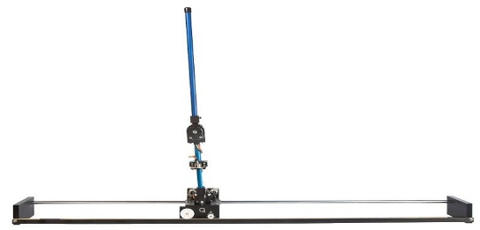
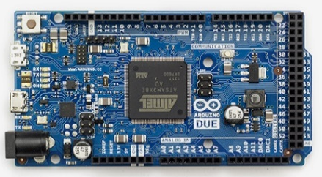
Prospective Setups – Rapid Control Prototyping
Rapid control prototyping design procedure
1. Build HW
2. Derive a mathematical model of the system → Lecture: Modeling and system identification
3. Implement controller in a rapid control prototyping (RCP) platform (here: MATLAB/Simulink with Arduino) and test it in simulations
4. Apply controller to real system
The rapid control prototyping environment
→ getting started with our ECP-tutorial
MATLAB/Simulink
Arduino Due
Hardware setup
USB
Source: https://www.arduino.cc

Slide 11
Agenda
Introduction
Teams and supervision
Prosepective control setups
Formalities (5 Slides)
Getting started

Slide 12
Formalities - Order of events
Kick-off meeting 20.10.2016 14:00 – 16:00 (102 01-012)
Security instructions 27.10.2016 13:00 – 17:00 (051 00-022) & Tutorial Part I
Project plan presentation 03.11.2016 14:00 – 16:00 (102 01-012)
Interim presentation 15.12.2016 14:00 – 16:00 (102 01-012)
Final presentation (public) 10.02.2017 10:00 – 12:30 (101 00-010/14)
Final report 17.02.2017
Attendance to all events is mandatory

Slide 13
Formalities - Presentations and Report
Presentations (project plan, interim, final)
15 minutes per group
Every team member has to present (→ ca. 5 minutes per person)
PowerPoint or LaTeX (templates provided)
Demonstrations (in final presentation)
Final report
Format: Wiki page
http://wiki.syscop.de/Embedded_Control_Project_(ECP)_WS1617
Example for writing a wiki page
Contents
Sections: (example) common introduction, mechanical setup, electrical setup, software structure, controller design, user manual
Each team member writes own section(s) (in total at least 2000 words)
Indicate author of each section

Slide 14
Formalities – Grading
Admission Registration in HisInOne is done by our lab
Workload 6 ECTS credits → 180h (ca. 13h per week in average)
Grading
Each team member is graded individually
Final presentation: 30%
Final report: 70%
Plagiarism results in 5.0

Slide 15
Working space and workshop
Permanent working space
Building 51 room 00-029 (Team 1, 2, 3)
Building 74 room 14 (Team 4, 5)
Store your setup here
Only limited ammount of lab power supplies, soldering stations, multimeters
Access to workshop
Building 51 room 00-022
Soldering stations, lab power supplies, oscilloscopes, multimeters, drills, saws, small electronic parts (resistors, capacitors, etc.)
Access by Uni-Card
Tuesdays: 13:00 – 17:00
Thursdays: 13:00 – 17:00
Tutors are in the workshop to these times
Do not use the workshop at other times
Do not leave your setup in the workshop

Slide 16
Formalities – Accounts
Each group has an own
Syscop-owncloud folder (for data storage)
What is owncloud? (https://doc.owncloud.org/server/9.1/user_manual/)
Access via web (https://cloud.syscop.de/) or client (download: https://owncloud.org/install/)
put here data sheets, orders, pdfs, presentations, pictures, videos, etc.
“General Information“ folder contains important information (these slides, templates, etc.)
Syscop-Gitlab repository (for version control)
What is version control? (https://git-scm.com/doc)
Use version control for software, e.g., for MATLAB files, C-Code
Install the git client (https://git-scm.com/downloads)
Optional but recommended: tortoiseGit (https://tortoisegit.org/download/)
Syscop-wiki page
http://wiki.syscop.de/
For writing final report
Also ECP-tutorial in wiki
Credential will be sent to you after this meeting

Slide 17
Agenda
Introduction
Teams and supervision
Prosepective control setups
Formalities
Getting started (2 Slides)

Slide 18
ECP-Tutorial
ECP-Tutorial
Idea: Build a simple electronic HW setup and interface/control it with Arduino + MATLAB/Simulink
Procedure
Design PCB with Target3001
in-class event 27.10.16 13:00 – 17:00 at workshop (051 00-022)
Bring laptop with internet connection + mouse
Please install Target3001(V18) before the event (exe-file in owncloud)
Soldering and putting tutorial-setup in operation - on your own, ask tutors
Interfacing/controlling HW via Arduino and MATLAB/Simulink - step-by-step tutorial in wiki (http://wiki.syscop.de/ECP_Tutorial)

Slide 19
Next Steps
Software
Install Target3001(V18)
Register for a MATLAB licence (can take a couple of days) and install MATLAB including Control Toolbox, Simulink, Simulink Realtime Toolbox
ECP-Tutorial
Come to first session (in 1 week)
Have a meeting with your tutor
Preferably within 1 week
Definitely before project plan presentation in 2 weeks

Slide 20
Thank you for your attention

