Slide 1
WP3
Sensors and Estimation
Jeroen Hol, PhD

Slide 2
WP3 Sensors and Estimation
Sensor information is crucial for control in AWE
  Reliability and safety
  Extreme flight and weather conditions
  Periodic orbits
  Increase power output
WP topics
  Nonlinear Model Predictive Control (NMPC)
  Moving Horizon Estimation (MHE)
  Actuator and sensor fault detection
  Embedded and real-time implementations

Slide 3
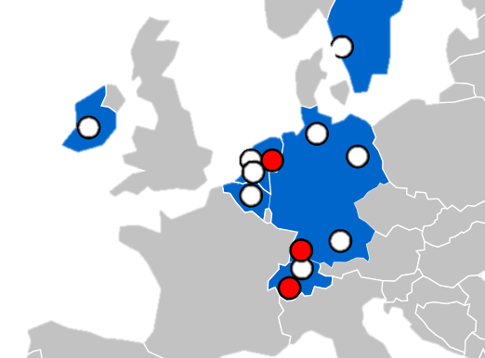
Partners & People
ALU-FR
  Moritz Diehl
Xsens (WP leader)
  Jeroen Hol
EPFL
  Colin Jones

Slide 4
Fellows & Topics
Efficient Numerical Methods for Embedded Optimization in AWE Applications
  Andrea Zanelli
State and Parameters Estimation Implementations Based on MHE
  Fabian Girrbach
Estimation and Control of Periodic Orbits
  Petr Listov

