Slide 1

HIGHWIND Hardware
Thorbjörn Jörger
Lehrstuhl für Systemtheorie
Institut für Mikrosystemtechnik - IMTEK
Albert-Ludwigs-Universität Freiburg

Slide 2
Responsibilities
  All HIGHWIND hardware
    Carousel
    Airplanes
    Sensors
    Actuators
  Components communication and interfacing
    Interface definition (BETCOM)
    Implementing communication
  Control software
    Carousel (OROCOS)
    Flight hardware
  Visualisation

Slide 3
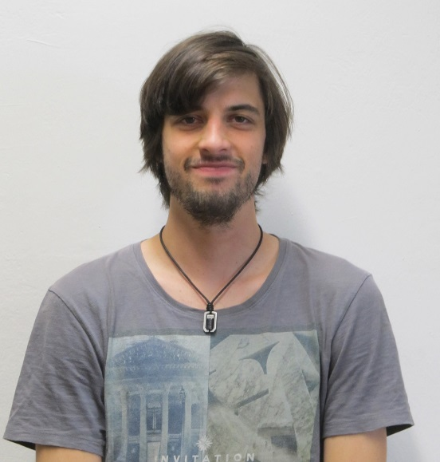
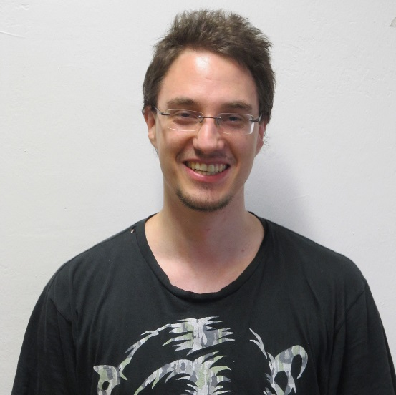
Team: Communication & Visualisation
  Elias Rosch:
    B. Sc. Embedded Systems Engineering
    Currently master studies ESE
    With HIGHWIND since April 2014
  Julian Reimer
    B. Sc. Embedded Systems Engineering
    Currently master studies ESE
    With HIGHWIND since December 2014

Slide 4
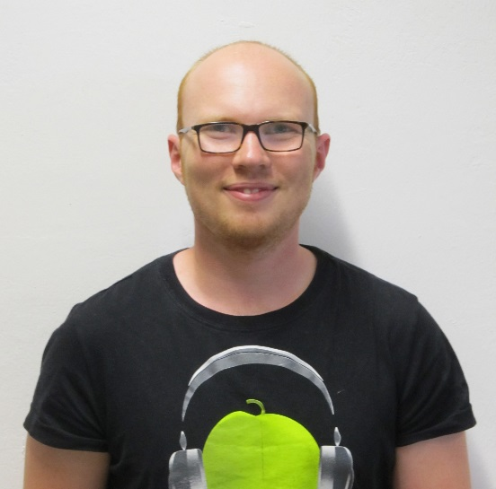
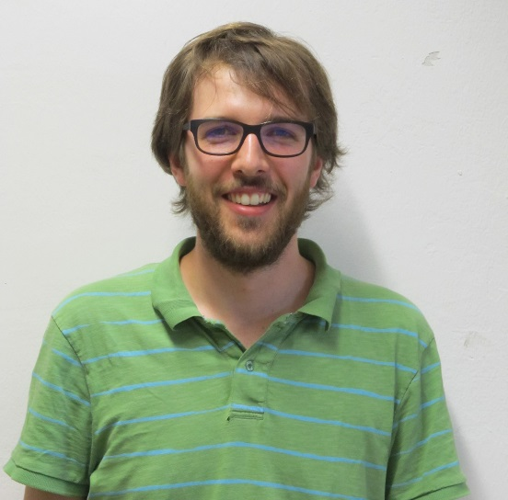
Team: Flight software
  Fabian Girrbach
    B. Sc. Embedded Systems Engineering
    Currently master thesis ESE
    With HIGHWIND since April 2014
  Maximilian Ernestus
    B. Sc. Informatik
    Currently master studies Cognitive Sciences
    With HIGHWIND since March 2015

Slide 5
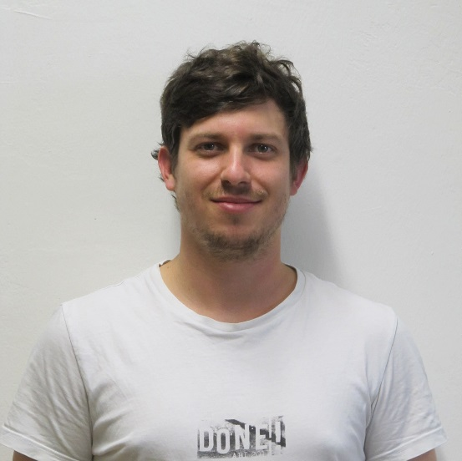
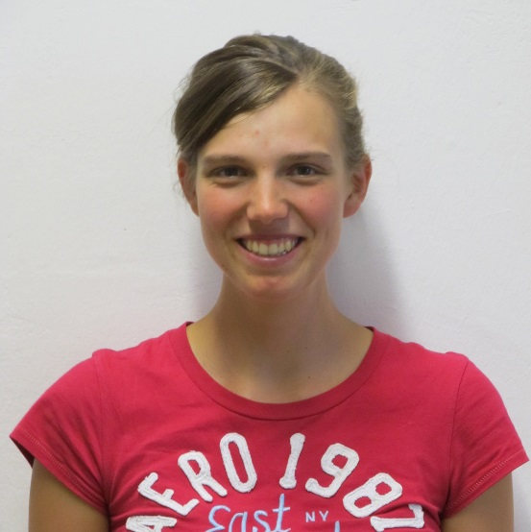
Team: Flight hardware
  Ben Schleusener
    B. Sc. Microsystems Engineering
    Currently master studies MST
    With HIGHWIND since September 2013
  Joanna Greulich
    Currently bachelor studies MST
    With HIGHWIND since April 2015

Slide 6
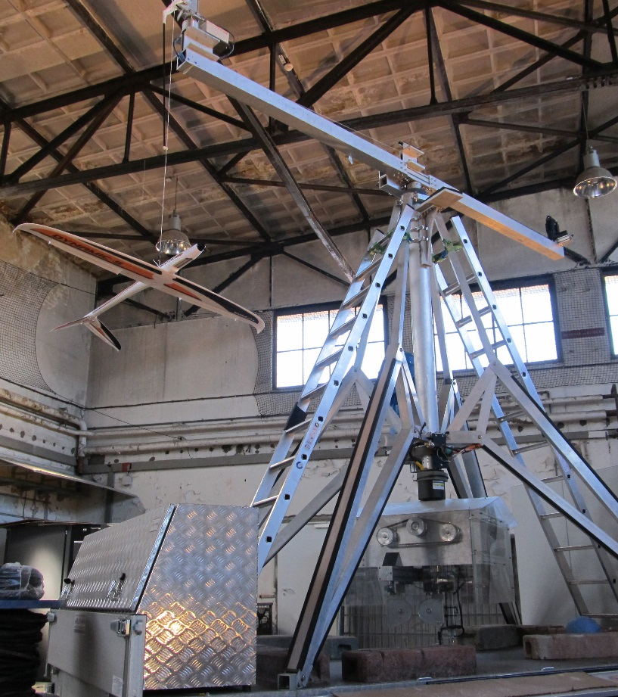
Carousel
Target: Black Box for users
  PLC and motor drives
    Fixed all bugs
    Hard coded limits for safety
    Stable communication to Groundstation
  Clean interface to OROCOS
  Safety measures implemented
    Warning lights
    Speed limits
Now: Fire and Forget

Slide 7
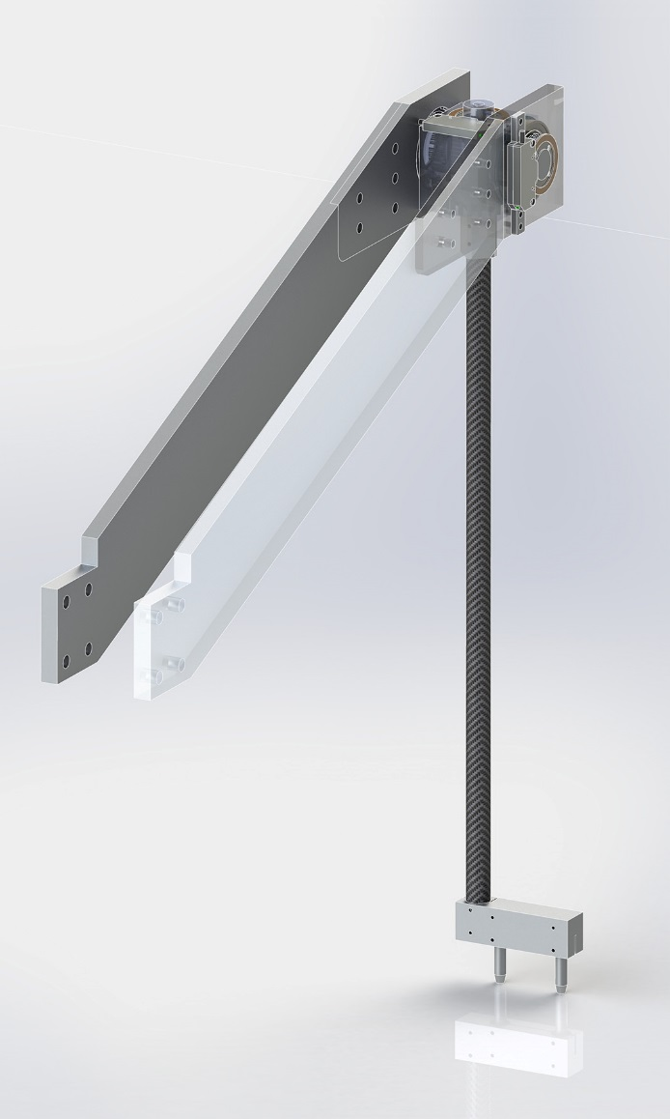
Rod mounted half-wing airplane
  Intermediate step to tethered flight
  Only two degrees of freedom
    Much easier to control
    Easy task for testing the setup
  Hard limits for elevation and rotation
    No dangerous angles of attack
  Absolute angular sensors
    Accurate position over ground
    But angle of attack is most likely different
    Reference for state estimation with IMUs
  Clean interface to OROCOS
    Black Box for experimenters

Slide 8
Sensor fusion
  It is desirable to have all sensors fused at one point
    Time keeping and synchronisation much easier
    Easier to maintain
  Fast and low jitter connection to controller
    More time for NMPC calculations in each time step

Slide 9
Sensor fusion
  It is desirable to have all sensors fused at one point
    Time keeping and synchronisation much easier
    Easier to maintain
  Fast and low jitter connection to controller
    More time for NMPC calculations in each time step
Past:

Slide 10
Sensor fusion
  It is desirable to have all sensors fused at one point
    Time keeping and synchronisation much easier
    Easier to maintain
  Fast and low jitter connection to controller
    More time for NMPC calculations in each time step
Present:

Slide 11
Sensor fusion
  It is desirable to have all sensors fused at one point
    Time keeping and synchronisation much easier
    Easier to maintain
  Fast and low jitter connection to controller
    More time for NMPC calculations in each time step
Future:

Slide 12
Sensor fusion
  It is desirable to have all sensors fused at one point
    Time keeping and synchronisation much easier
    Easier to maintain
  Fast and low jitter connection to controller
    More time for NMPC calculations in each time step
Future?

Slide 13
Time keeping
  Each measurement gets a time stamp in a unified time frame
  From the time stamping on, all delays can be taken into account by the controller and the state estimator
    System is now calibration free
  Execution time for actuator commands can be set
  But need for synchronous clocks

Slide 14


Clock synchronization
  Reference pulse which occurs simultaneous in both systems
  1PPS signal of GPS is the natural choice for outdoor experiments
    no information exchange between systems necessary
    Absolute and jump-free GPS time reference is also available
    Small jitter (15-50 ns) with cheap equipment, < 1 ns with better equipment
    Indoor Environment usually has to low signal strength

Slide 15
Clock synchronization
Necessary
  Reference pulse which occurs simultaneous in both systems
  1PPS signal of GPS is the natural choice for outdoor experiments
    no information exchange between systems necessary
    Absolute and jump-free GPS time reference is also available
    Small jitter (15-50 ns) with cheap equipment, < 1 ns with better equipment
    Indoor Environment usually has to low signal strength
    To much manpower necessary
Nice to have

Slide 16
Clock synchronization
  Reference pulse which occurs simultaneous in both systems
  “1PPS” signal generated by BeagleBone
    Simple and reliant
    Quick to implement
    Hardware programming portable for real 1PPS
    Additional cables necessary (bad for tethered flight)

Slide 17
BETPROT: Overview
  Clean message based interface between all components
  Defines messages containing data, controls and configuration
  Based on protobuf, which is already used in OROCOS
  High flexibility through platform and protocol independence

Slide 18
BETPROT: Messages
  Messages are defined as either:
    Required (exactly one message of this type required per packet)
    Optional (zero or one message of this type contained per packet)
    Repeated (zero to multiple messages of this type contained per packet)
    This allows high flexibility, sensors can be added, cconfigured or neglected easily
  Messages can be nested:
  msg BETPROTO:
    required msg BETCALL
      required uint32 pps
      required uint32_t ticks
      repeated msg Airspeed
        required uint32_t pps
        required uint32_t ticks
        required uint32_t airspeed_raw
        optional uint32_t debug_info
        …
    msg BETPUSH
    …

Slide 19
HIGHWIND Communication and Visualisation
Elias Rosch, Julian Reimer
Lehrstuhl für Systemtheorie
Institut für Mikrosystemtechnik - IMTEK
Albert-Ludwigs-Universität Freiburg

Slide 20
Protocol: BetProt
  Communication between Groundstation and BB
    via Ethernet / TCP
    Communication­ Framework ZMQ
  Messages defined via Google Protobuf:
    BetCall contains Sensordata
    BetPush contains Actuatordata

Slide 21
BetCall
  Message generated by BB
  Submessages contain:
    Values for different axes
    Timing information
  Receiver
    Forwards messages to visualizer
    unpacks messages into the datastructure Sensorcontainer
  OROCOS handles Sensorcontainer
IMUs plane
Gps
Line angle
Airspeed
Angle of attack
Timestamp
Dms
Ticks
IMUs arm

Slide 22
BetPush
  Message generated by GS
  OROCOS fills Actuatorcontainer
  Sender packs messages from Actuatorcontainer
Ticks
Elevator
Rudder
Ailerons
Flaps

Slide 23
BetConf
  Message generated by GS
  OROCOS fills Configcontainer
  Sender packs messages from Configcontainer
Activation of Sensors
Update rate
General configuration of flight control

Slide 24
BetVisualizer
  Receives BetCall messages
    Generates visual feedback from current sensor- and timingdata
IMU arm
IMU plane
Line angle

Slide 25
HIGHWIND Flight software
Fabian Girrbach, Maximilian Ernestus
Lehrstuhl für Systemtheorie
Institut für Mikrosystemtechnik - IMTEK
Albert-Ludwigs-Universität Freiburg

Slide 26
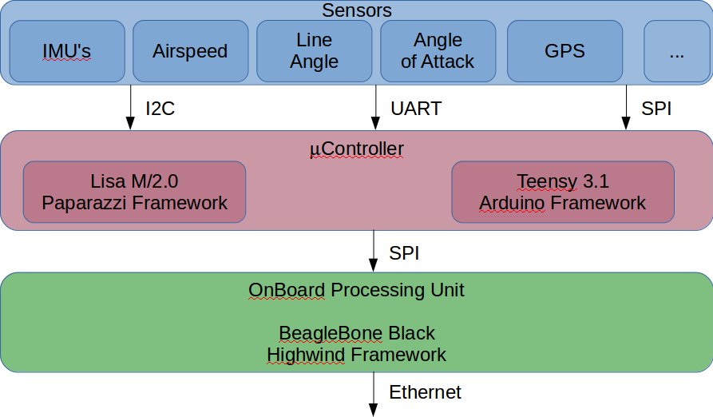
Sensing setup

Slide 27
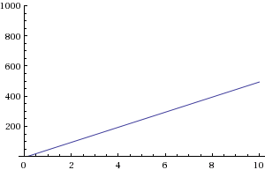
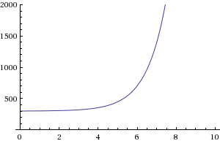
Why two frameworks?
Framework | Paparazzi | Arduino
Pros: | - Rich features for autonomous flying - Open source project with many experts involved | - Rich library and example database - Multi-purpose and multi-solution
 | - Dependencies between modules have to be considered - More complex code structure and debugging | - In general lower quality of code - Focus on simplicity instead of performance
Learning Curve:

Slide 28
HIGHWIND Flight hardware
Ben Schleusener, Joanna Greulich
Lehrstuhl für Systemtheorie
Institut für Mikrosystemtechnik - IMTEK
Albert-Ludwigs-Universität Freiburg

Slide 29
Delay overview
  Standard ethernet is a bad choice for real time applications

Slide 30
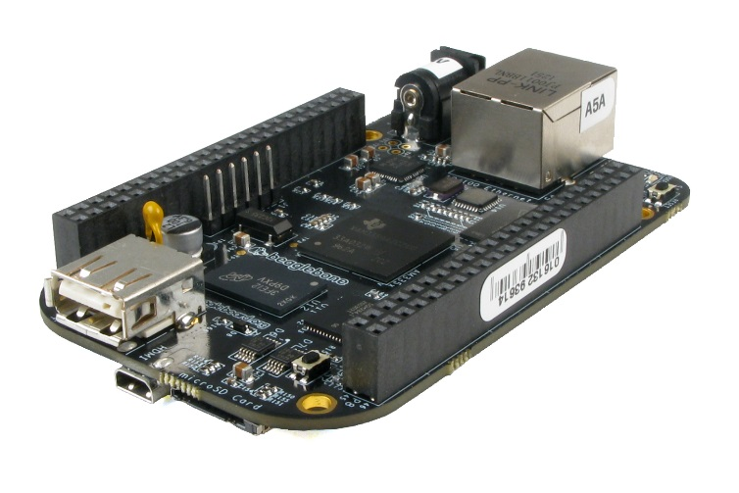
Delay overview
  Common time base is needed
  Beaglebone generates 1PPS-signal

Slide 31
Derivation of time from 1PPS
  1PPS pulses are numbered consecutively
  Intervals between 1PPS are counted with 8 MHz (ticks)
    125 µs resolution
  On rising flag, pulse counter is incremented and tick counter reset
  Time stamp consist of ticks and pulse number
  The pulse number is referenced in the GS to UTC time frame
    The GS then calculates absolute timestamps for the measurements

Slide 32
Challenge Helvetica 28 pt
  You can also put pictures here if they have the appropriate for
  Helvetica is attached, otherwise use Arial and tell me, I will change it then (Arial is Helveticas bastard son just by the way xD)
  PW: mjolnir111!%%mjolnir

