Slide 1
Parameter/State Estimation and Trajectory Planning of the Skysails flying kite system
Jesus Lago, Adrian Bürger, Florian Messerer, Michael Erhard Systems control and optimization laboratory- IMTEK University of Freiburg, Germany

Slide 2
Overview
System Model
State estimation
Importance of wind direction estimation
Results
Parameter estimation
Introduction to PECas
Parameter estimation results
Planning of optimal trajectories

Slide 3
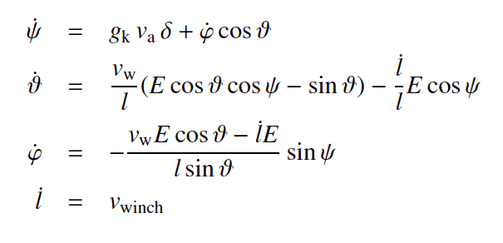
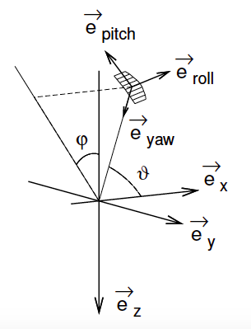
Flying kite model dynamics
State space:
ϑ: angle tether-x axis (wind direction)
φ: angle tether projected XZ plane and z axis
ψ: angle roll axis and wind direction
l: tether length
Others:
v_{a}: air path speed
Inputs:
δ: steering deflection
v_{winch}: winch speed
Parameters
E: glide ratio of the kite
g_{k}: proportional gain
v_{w}: wind speed at kite altitude

Slide 4
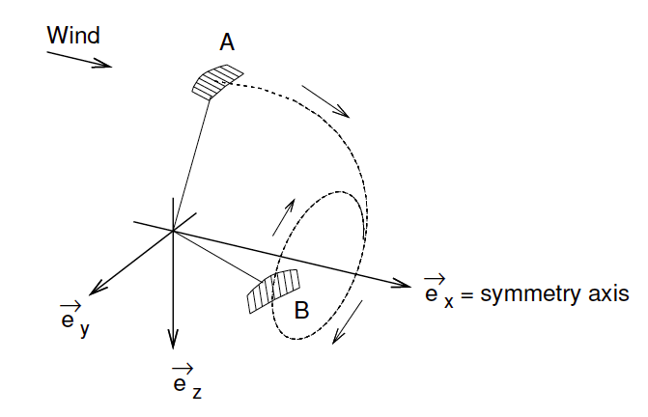
Kite model dynamics
Motivation:
Simplified dynamics
Symmetric w.r.t wind direction (x-axis)
Accurate for state prediction
Fast for online estimation
Probably suitable for NMPC

Slide 5
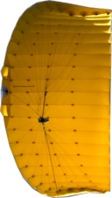
State Estimation – Main Motivation
Wind importance in the model
Model referenced respect to wind direction
Wind speed included in the model
Wind direction and speed measured at ground differs from flight altitude
→ Some estimation needed
?
?
?
?
?

Slide 6
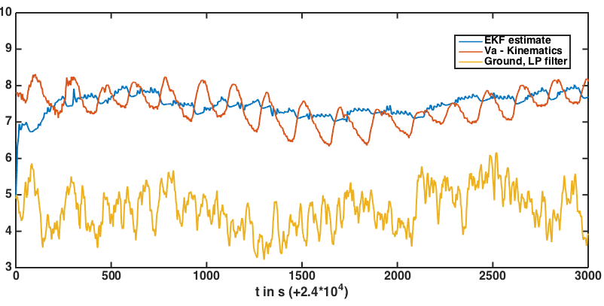
State Estimation – Wind Speed Results
Ground unit data useless for wind estimation at flight altitudes
Current estimation: variability → power vs. retraction phase
EKF based on model: better estimation with lower variability

Slide 7
Introduction to PECas
Easy-to-apply parameter estimation software for application within the HIGHWIND project
Uses a direct collocation approach using IPOPT from CasADi
Provides possibilities for comfortable results interpretation
Main developer: Adrian Bürger (Still under development)
Tutorial, documentation and more: syscop.de/pecas

Slide 8
Parameter Estimation
Motivation
Change in parameters shows changes or problems in flying conditions
Online estimation of parameters desired
Challenges
Fast estimation for real time implementation
Simplified dynamical model → not every assumption holds constantly
Model sensitive to wind direction
Unknown variance of measurement errors → weighting matrix problem

Slide 9
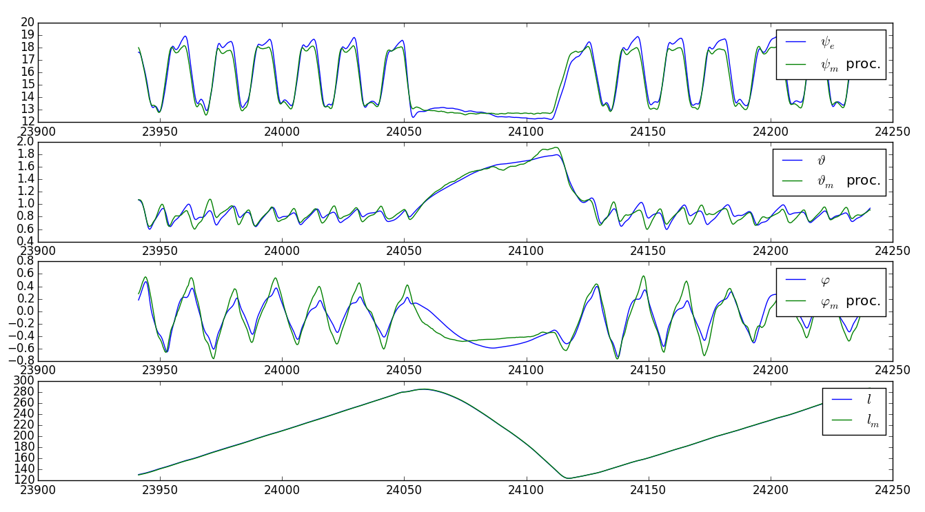
Parameter Estimation – Main results
Setup of best trade off accuracy vs speed
T = 0.4 s - f = 2.5 Hz
5 minutes horizon – 40 minutes of data analyzed
Collocation structure - 3rd order polynomial
70 s. simulation time
E = 4.1 ± 0.23
gk = 0.087 ± 0.002
R² = 99 %

Slide 10
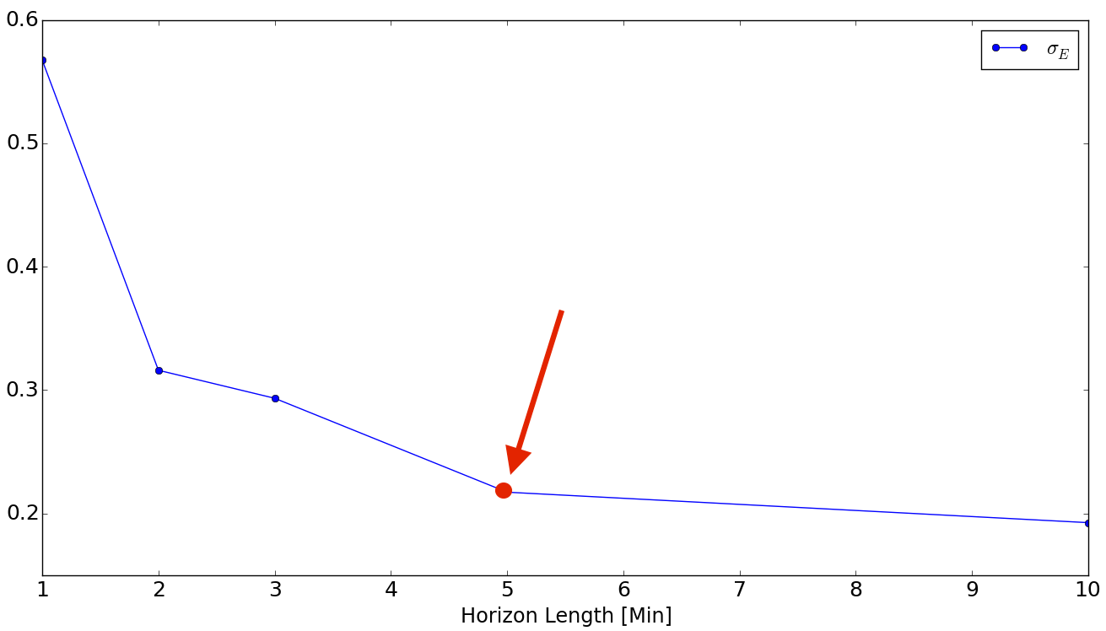
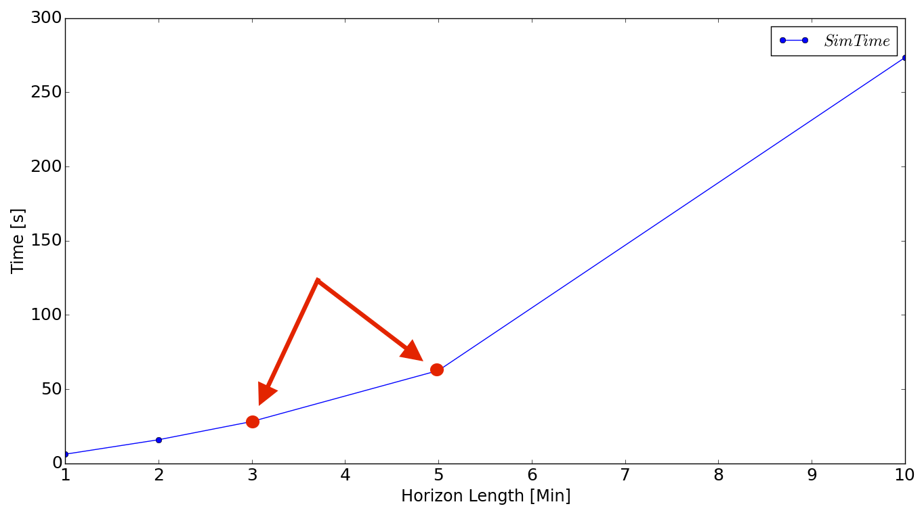
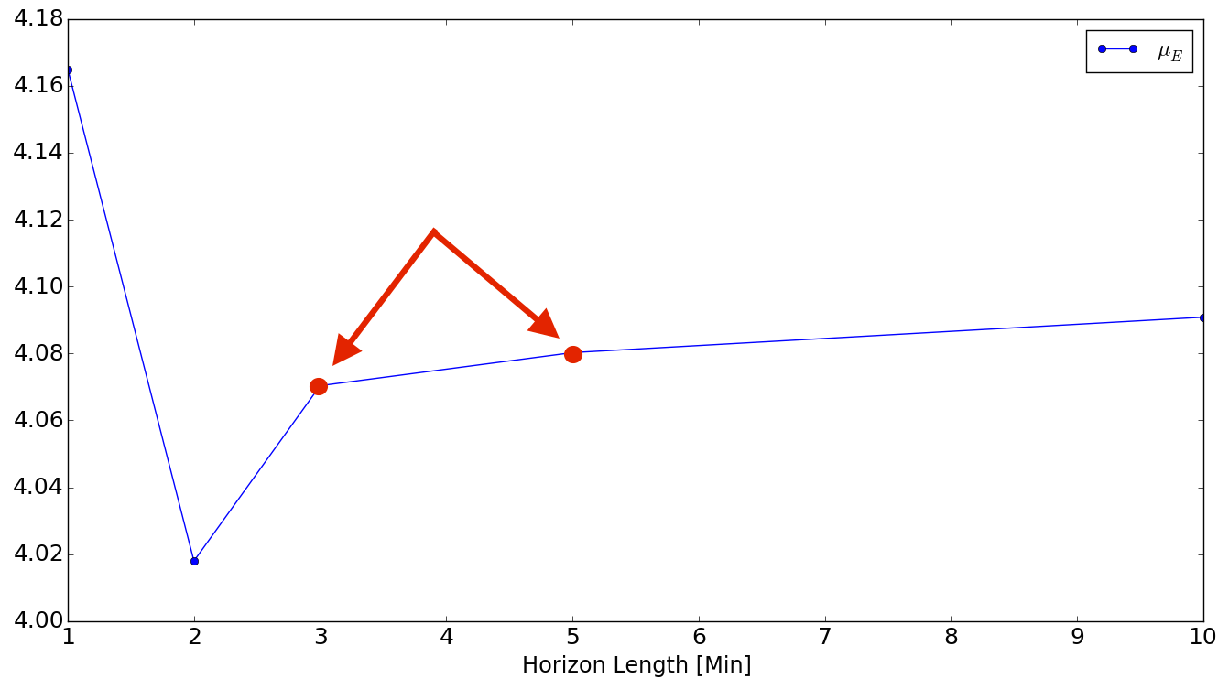
Parameter Estimation – Trade off
Study of horizon length:
σ_{E} and estimation time as critical parameter
Trade off accuracy vs. speed: 5 minutes

Slide 11
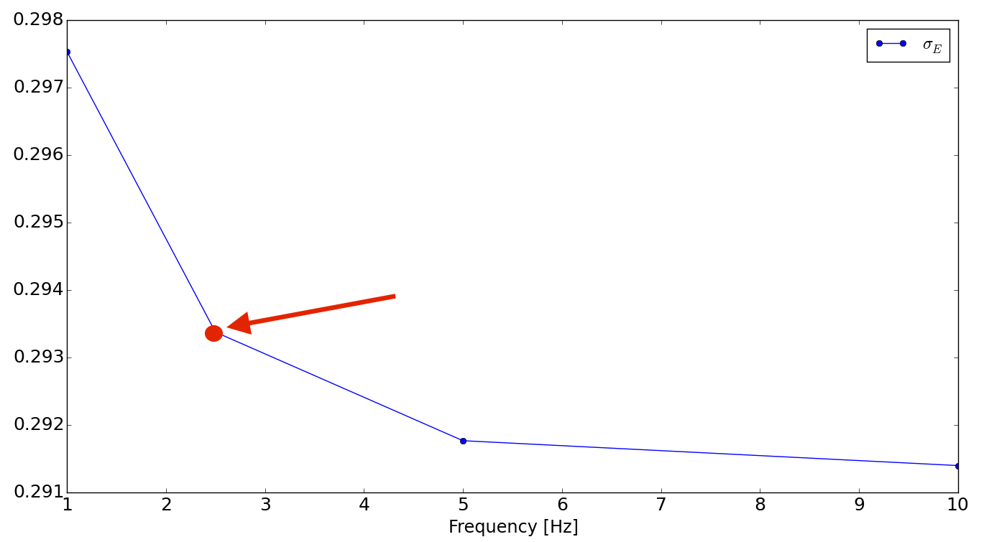
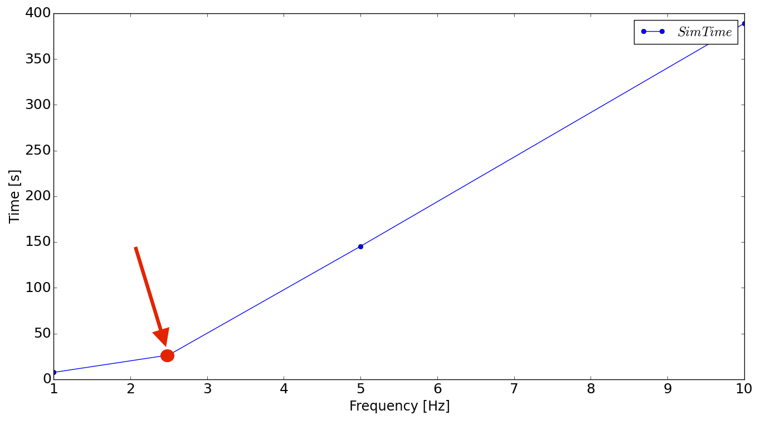
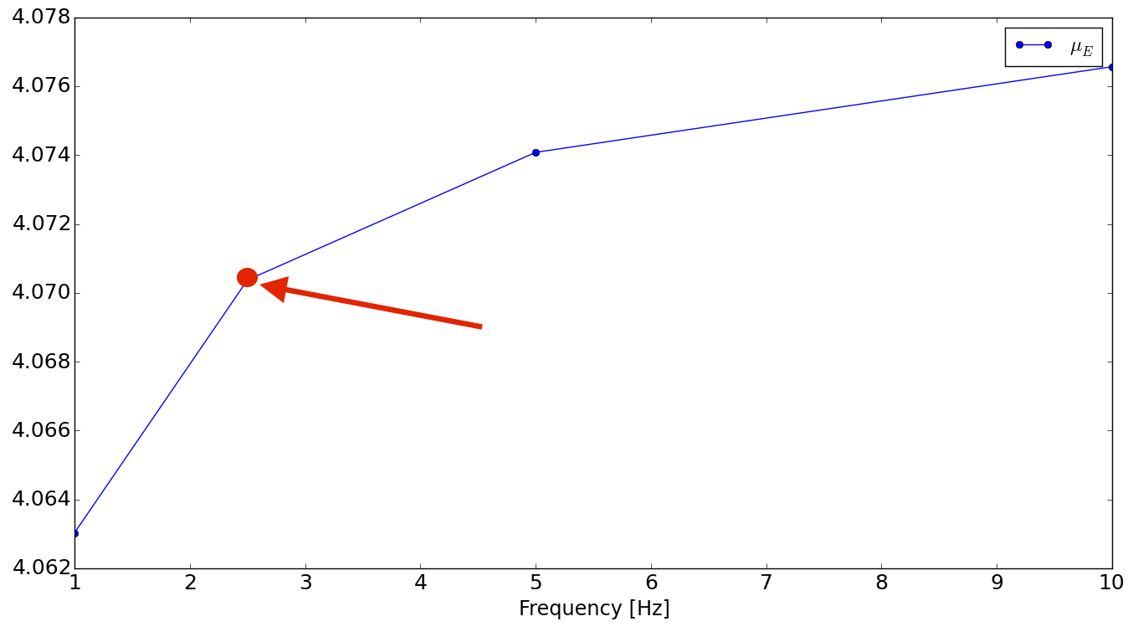
Parameter Estimation – Trade off
Study of sampling frequency:
σ_{E} low variability, mostly estimation time critical
Trade off accuracy vs. speed: 2.5 Hz

Slide 12
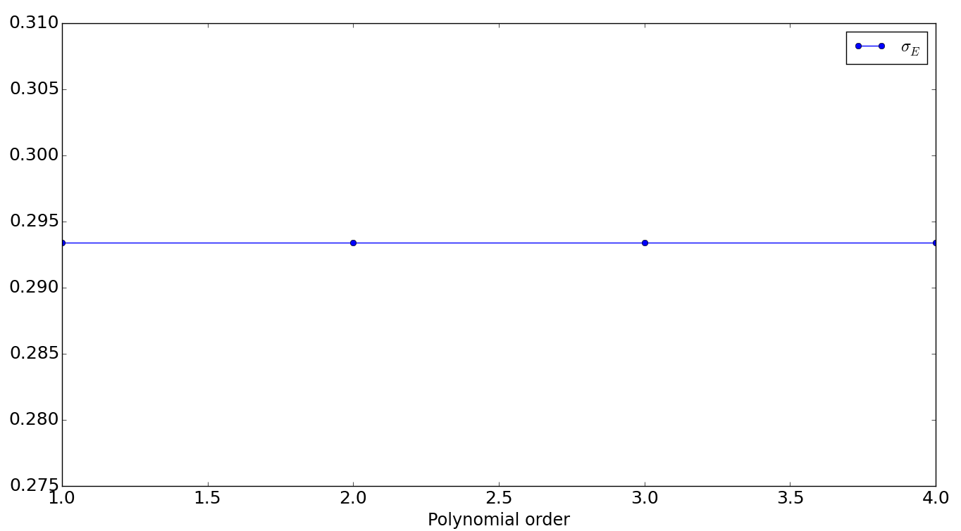
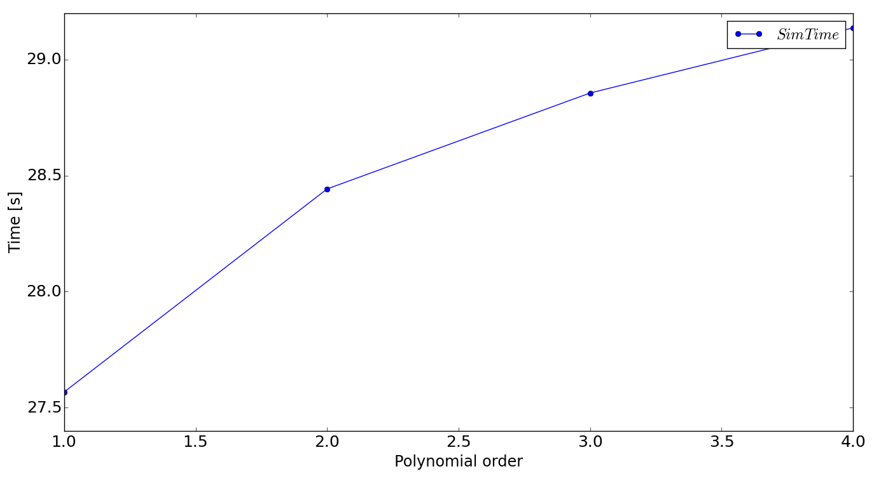
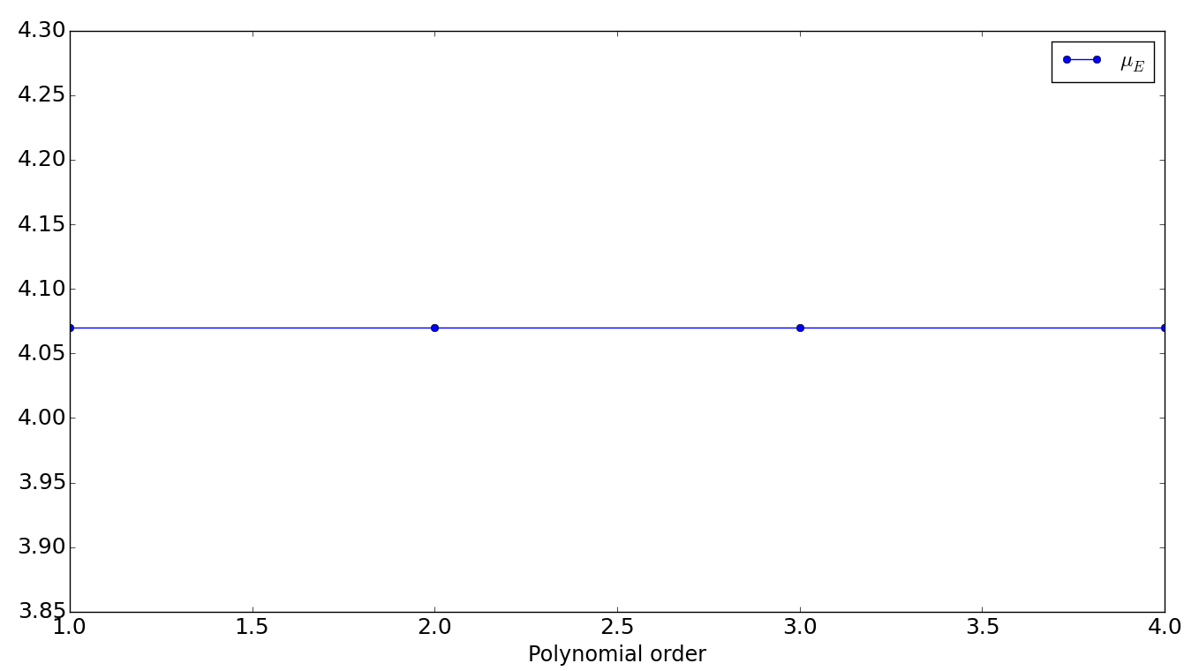
Parameter Estimation – Trade off
Study of polynomial order:
No influence on σ_{E} , almost no influence on estimation time

Slide 13
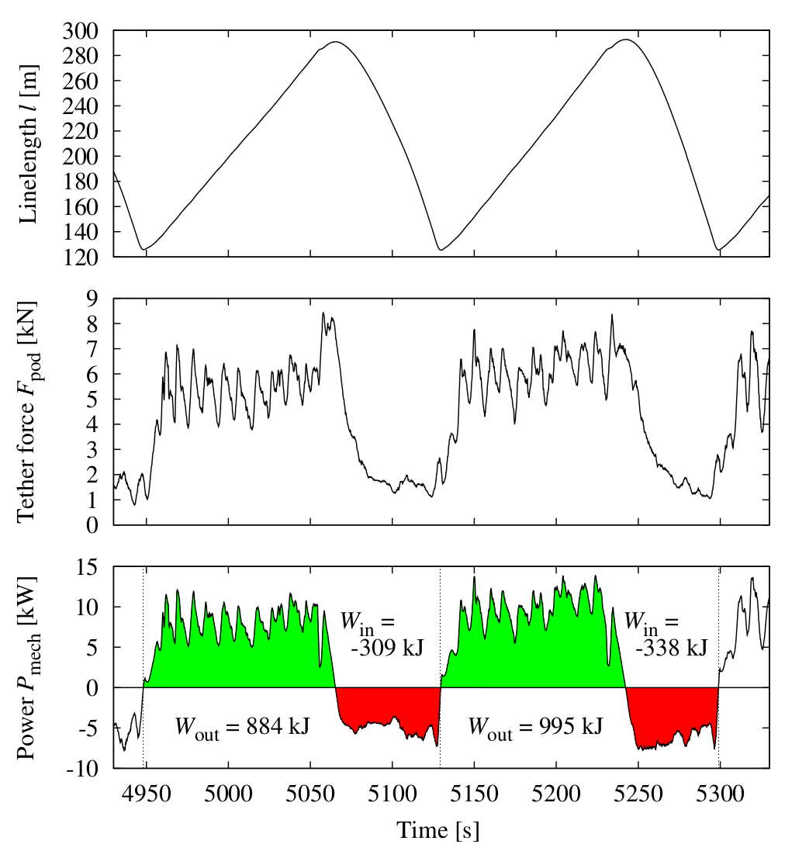
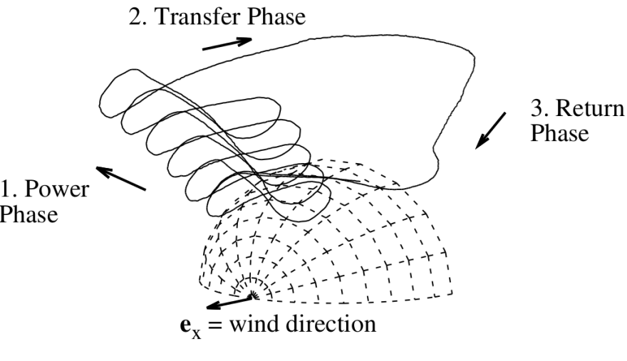
Optimal trajectory planning
Experimental cycles
M. Erhard, H. Strauch, Flight control of tehered kites in autonomous pumping cycles for airborne wind energy, Control Engineering Practice (2015),
http://dx.doi.org/10.1016/j.conengprac.2015.03.001
→ But, are they optimal?

Slide 14
Optimal trajectory planning - Video
Problem
Algorithm
Casadi implementation
Multiple shooting
250 states
Video

Slide 15
Conclusion
Different ongoing work:
State / Parameter estimation
Trajectory Planning
Several obstacles / constrains:
Computing speed
Accuracy
Future plan
Use current work to implement NMPC for trajectory control and test NMPC controller with real SkySails Power prototype

Slide 16
Thank you for your attention. Questions/suggestions are welcome!

