Slide 1
Aerospace Modeling Tutorial Lecture 2 – Basic Aerodynamics
Greg and Mario
February 2, 2015

Slide 2
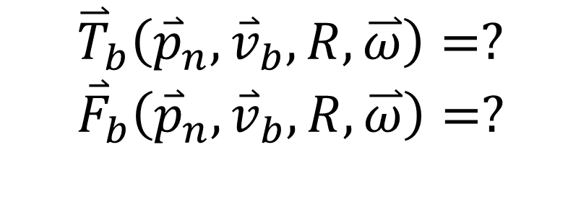
Our system dynamics:
$$\left(\begin{matrix}{\dot{r}}_{11} & {\dot{r}}_{12} & {\dot{r}}_{13} \\ {\dot{r}}_{21} & {\dot{r}}_{22} & {\dot{r}}_{23} \\ {\dot{r}}_{31} & {\dot{r}}_{32} & {\dot{r}}_{33}\end{matrix}\right)=\left(\begin{matrix}0 & ω_{z} & {−ω}_{y} \\ {−ω}_{z} & 0 & ω_{x} \\ ω_{y} & {−ω}_{x} & 0\end{matrix}\right)\left(\begin{matrix}r_{11} & r_{12} & r_{13} \\ r_{21} & r_{22} & r_{23} \\ r_{31} & r_{32} & r_{33}\end{matrix}\right)$$
$${\dot{\overset{⃑}{p}}}_{n}={R^{Τ}\overset{⃑}{v}}_{b}$$
$${\dot{\overset{⃑}{v}}}_{b}=\frac{{\vec{F}}_{b}}{m}−\overset{⃑}{ω}×{\overset{⃑}{v}}_{b}$$
$$\overset{̿}{J}∙ \dot{\overset{⃑}{ω}}=\overset{⃑}{ω}×\left(\overset{̿}{J}∙\overset{⃑}{ω}\right)+{\overset{⃑}{T}}_{b}$$
$${\overset{⃑}{T}}_{b}\left({\overset{⃑}{p}}_{n},{\overset{⃑}{v}}_{b},R,\overset{⃑}{ω}\right)=?$$
$${\overset{⃑}{F}}_{b}\left({\overset{⃑}{p}}_{n},{\overset{⃑}{v}}_{b},R,\overset{⃑}{ω}\right)=?$$

Slide 3
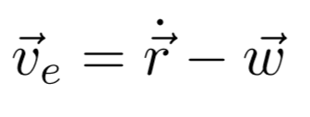
Our model

Slide 4
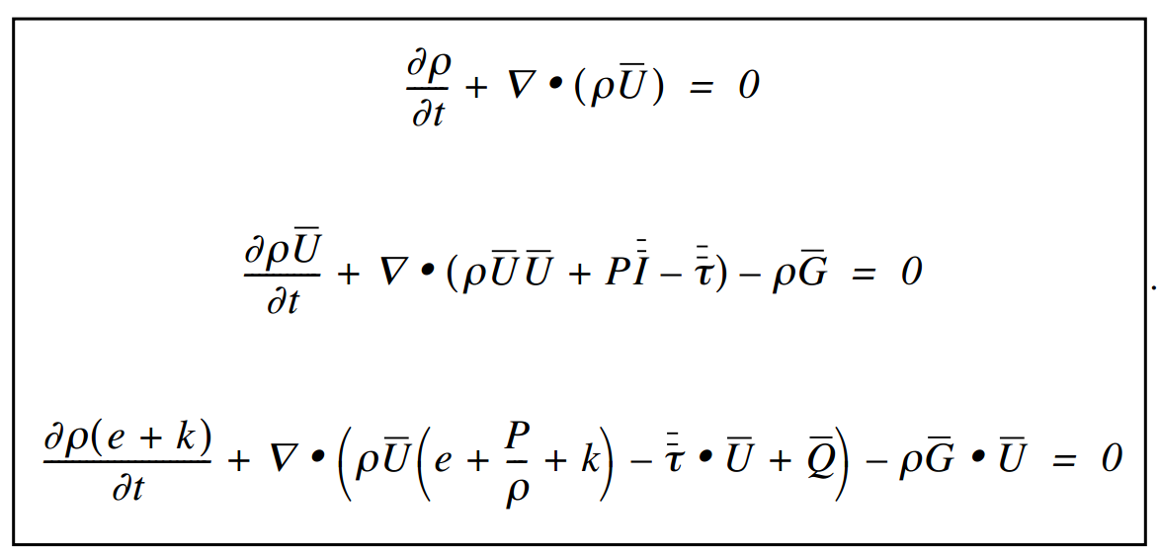
Navier Stokes Equations

Slide 5
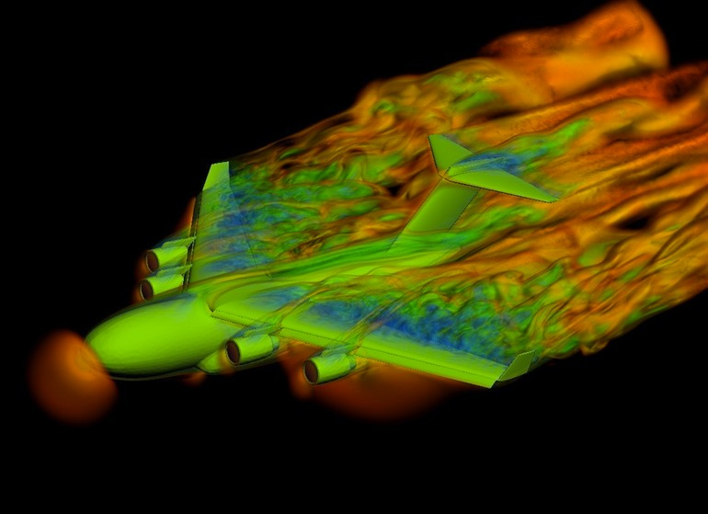
Solving Navier Stokes - CFD
Computationally demanding
Not suitable for real time simulation
Not suitable for dynamic optimization

Slide 6
How to simplify things?

Slide 7
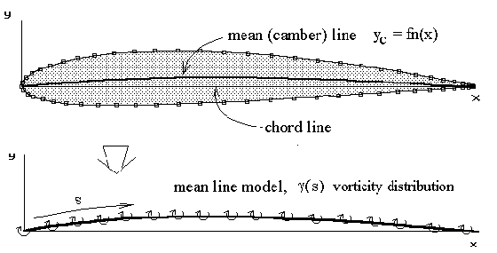
Thin airfoil theory
Assumptions:
2-dimensional flow
Inviscid flow
Incompressible flow
Solve simplified NS (just Laplace’s equation) with flow tangency condition

Slide 8
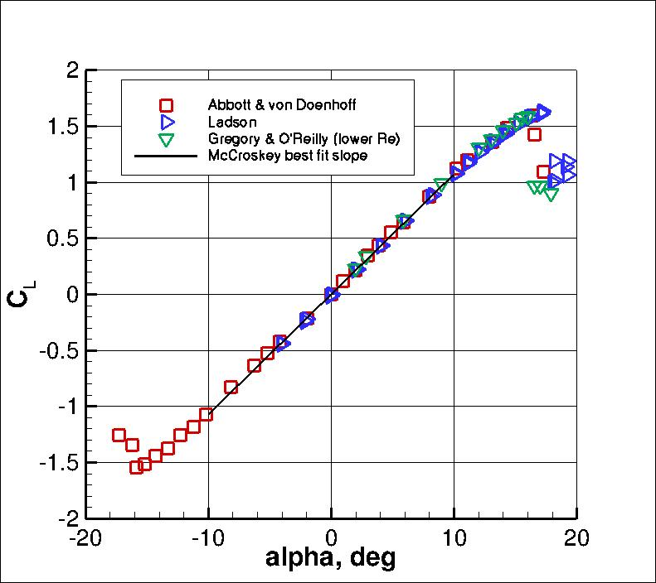
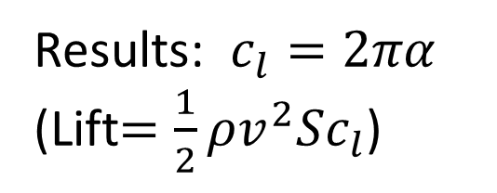
Thin airfoil theory
Results: $c_{l}=2πα$
(Lift$={\frac{1}{2}ρv^{2}Sc}_{l}$)
Advantages:
Easy to compute
Fits well to data
Drawbacks:
Predicts 0 drag
Real wings aren’t 2-dimensional

Slide 9
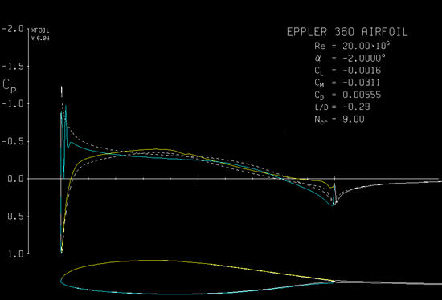
xfoil
viscous solution in the boundary layer
Inviscid outside
gives parasitic drag
still 2d

Slide 10
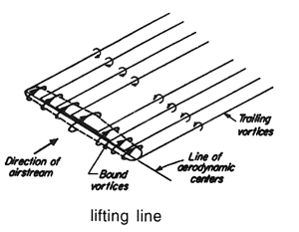
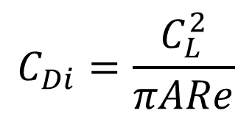
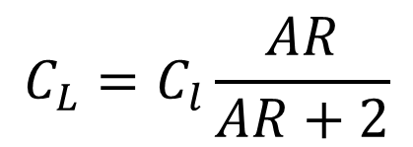
Prandtl lifting line theory
Still inviscid, incompressible
Model flow field as a sum of horseshoe vortices
Solve for circulation of each 2-d section
$$C_{Di}=\frac{C_{L}^{2}}{πARe}$$
$$C_{L}=C_{l}\frac{AR}{AR+2}$$
Still need to account for wing-tail interaction
Ignores spanwise viscous flow

Slide 11
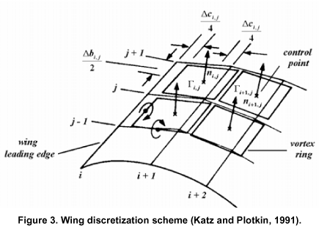
Vortex lattice
Model the wing as a panel of ring vortices
Can handle arbitrary shapes
Disadvantage: intrinsically computational, no handy formulas

Slide 12
AVL – Athena Vortex Lattice (Mark Drela)
popular code, includes parasitic drag
Inputs: geometry, alpha/beta/airspeed
Outputs: force/moment vectors + derivatives w.r.t. omega
Strategy: sweep alpha/beta, fit curves for all coefficients

Slide 13
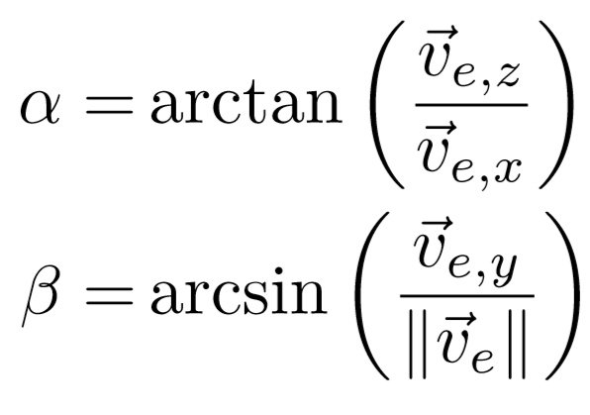
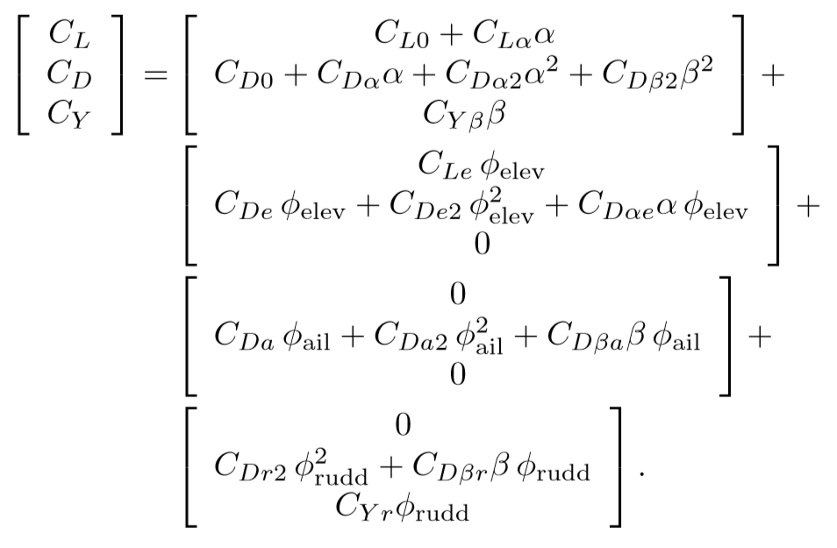
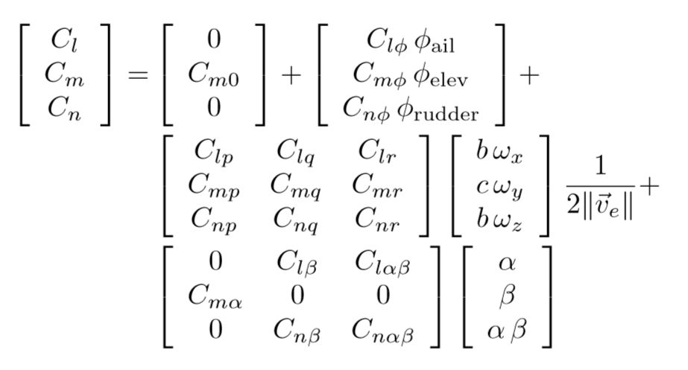
Our model

Slide 14
Homework 1: 2-dimensional model
Starting from [0,-10,10,0], fly as far as possible in 10 seconds, in the x direction
Starting from the same place, fly as long as possible (maximum time)
$$C_{D}=\frac{C_{L}^{2}}{πAR}+0.01$$
State:
$$C_{L}=2πα$$
Control input: α
Mass 2
Aspect ratio 10
Sref 0.5
Gravity 9.8
Altitude must always be positive!!

Slide 15
Homework 2 (optional): 3 dimensional model
Implement the full aerodynamic model, using coefficients from https://github.com/ghorn/rawesome/blob/master/rawe/models/betty_conf.py
(There is also a reference model there)
R(0) = eye(3)
p(0) = [0,0,0]
v(0) = [15, 0, 0]
ω(0) = [1, 0, 0]
Do something like, R(5.0)=eye(3), w(5.0) = [0,0,0], vy(5.0) = 0, minimize u^2
Probably best to simulate first to validate model

