Slide 1
Aerospace Modeling Tutorial Lecture 1 – Rigid Body Dynamics
Greg and Mario
January 21, 2015

Slide 2
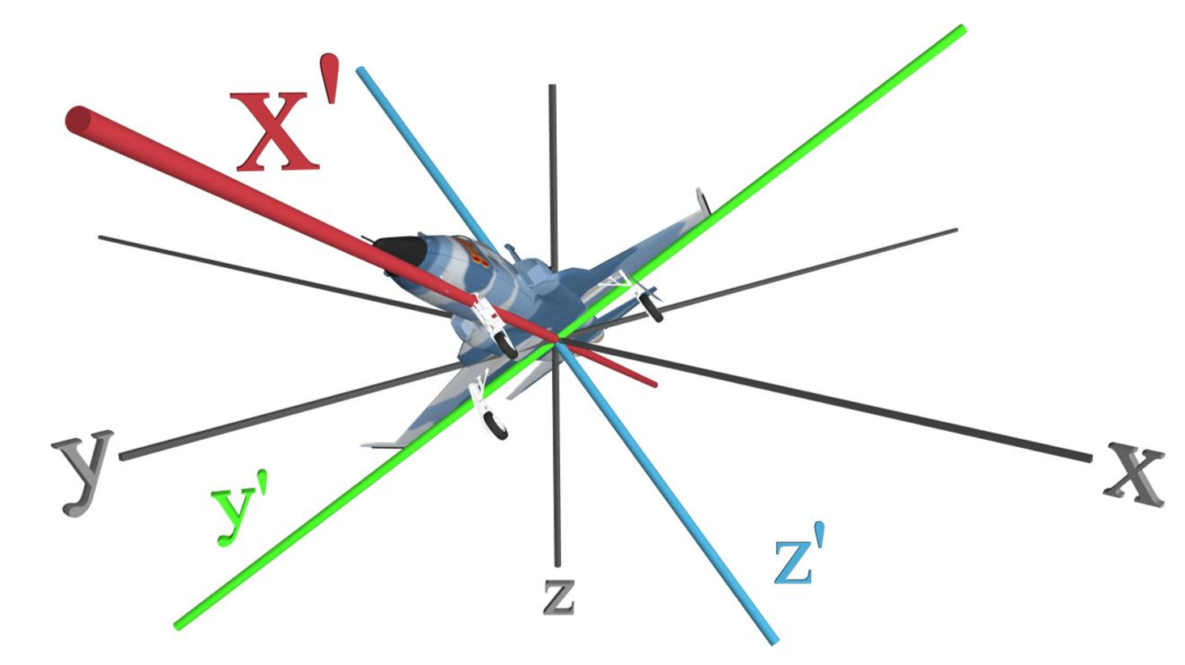
Reference frames
North-East-Down: $\left(\begin{matrix}x \\ y \\ z\end{matrix}\right)$
Body: $\left(\begin{matrix}x′ \\ y′ \\ z′\end{matrix}\right)$
Relative rotation: $\overset{⃑}{ω}$

Slide 3
Translational Dynamics
$${\dot{\overset{⃑}{v}}}_{n}=\frac{{\vec{F}}_{n}}{m}$$
$${\dot{\overset{⃑}{v}}}_{b}=\frac{{\vec{F}}_{b}}{m}−\overset{⃑}{ω}×{\overset{⃑}{v}}_{b}$$
$${\dot{\overset{⃑}{p}}}_{n}={\overset{⃑}{v}}_{n}$$
$${\dot{\overset{⃑}{p}}}_{n}={R^{Τ}\overset{⃑}{v}}_{b}$$

Slide 4
Rotational Dynamics
$$T=J\dot{ω}=J\ddot{θ}$$
(1 dimensional)
$$\overset{̿}{J}∙ \dot{\overset{⃑}{ω}}=\overset{⃑}{ω}×\left(\overset{̿}{J}∙\overset{⃑}{ω}\right)+{\overset{⃑}{T}}_{b}$$
(3 dimensional)
$\dot{\overset{⃑}{ω}}={\overset{̿}{J}}^{−1}[\overset{⃑}{ω}×\left(\overset{̿}{J}∙\overset{⃑}{ω}\right)+{\overset{⃑}{T}}_{b}$]

Slide 5
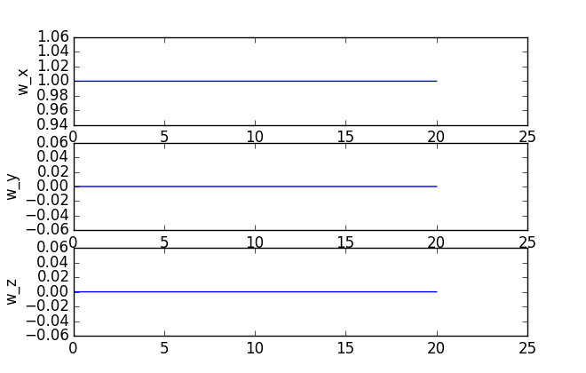
Rotational sim
$$ω\left(0\right)=\left(\begin{matrix}1 \\ 0 \\ 0\end{matrix}\right)$$
$$J=\left(\begin{matrix}1 & 0 & 0 \\ 0 & 2 & 0 \\ 0 & 0 & 3\end{matrix}\right)$$

Slide 6
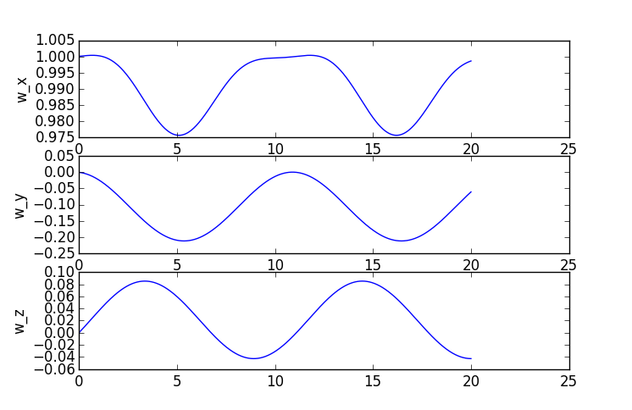
Rotational sim
$$ω\left(0\right)=\left(\begin{matrix}1 \\ 0 \\ 0\end{matrix}\right)$$
$$J=\left(\begin{matrix}1 & 0.1 & 0 \\ 0.1 & 2 & 0.4 \\ 0 & 0.4 & 3\end{matrix}\right)$$

Slide 7
We know the angular velocity, but not the angle
$$\dot{ω}=T/J$$
$$\dot{θ}=ω$$
super easy 1 dimension

Slide 8
How to model rotations – 1 dimension
$$\left(\begin{matrix}u_{x} \\ u_{y}\end{matrix}\right)=\left(\begin{matrix}\cos{θ} & \sin{θ} \\ −sin{θ} & \cos{θ}\end{matrix}\right)\left(\begin{matrix}v_{x} \\ v_{y}\end{matrix}\right)$$
$${\hat{n}}_{y}$$
$${\hat{b}}_{y}$$
$$\left(\begin{matrix}u_{x} \\ u_{y}\end{matrix}\right)=\left(\begin{matrix}3.1 \\ −0.4\end{matrix}\right)$$
$${\hat{b}}_{x}$$
$$\left(\begin{matrix}v_{x} \\ v_{y}\end{matrix}\right)=\left(\begin{matrix}3 \\ 1\end{matrix}\right)$$
θ
$${\hat{n}}_{x}$$

Slide 9
How to model rotations – 3 dimensional
First Idea:
Euler angles
(yaw, pitch, roll)

Slide 10
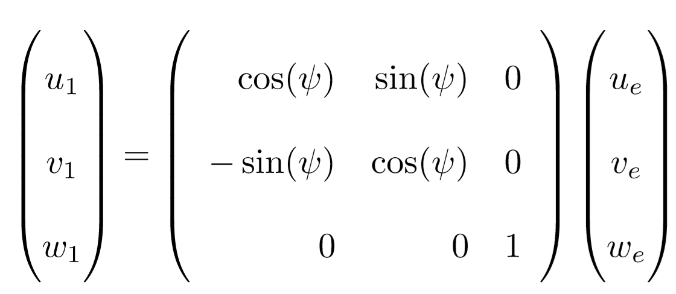
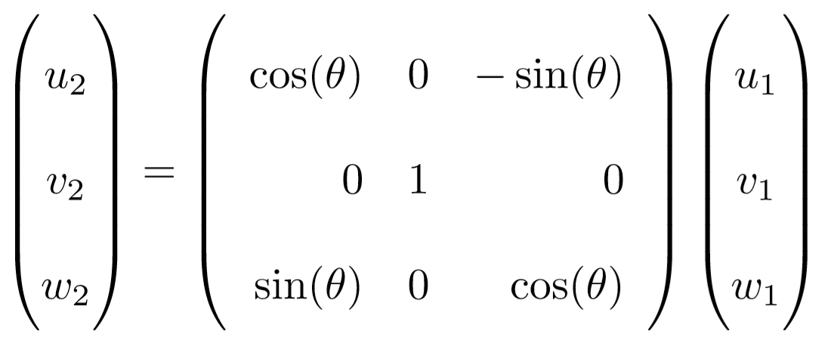
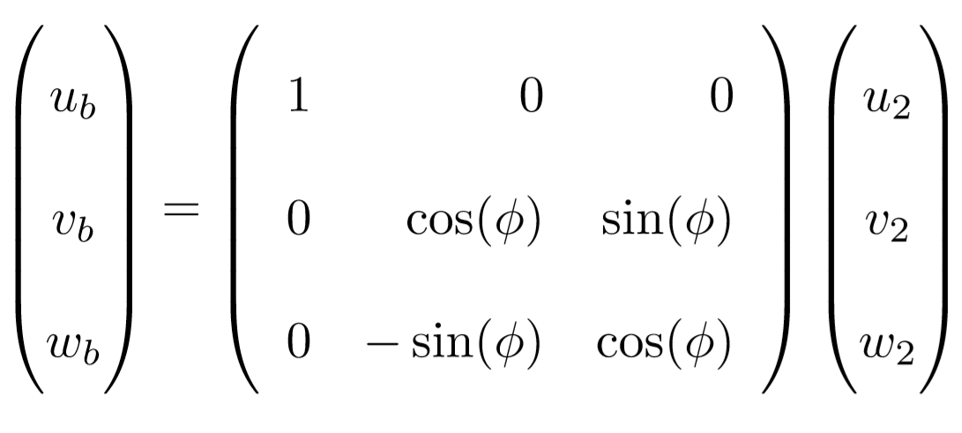
Euler angles – how do we express the rotation?
$$\left(\begin{matrix}u_{x} \\ u_{y} \\ u_{z}\end{matrix}\right)=\left(\begin{matrix}? & ? & ? \\ ? & ? & ? \\ ? & ? & ?\end{matrix}\right)\left(\begin{matrix}v_{x} \\ v_{y} \\ v_{z}\end{matrix}\right)$$

Slide 11
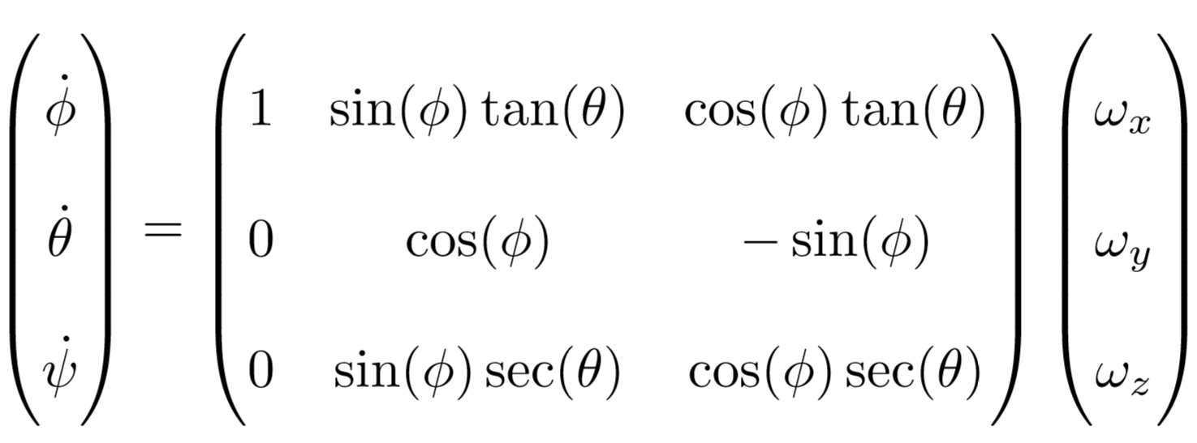
How do we use this with our rigid body equations?
$\dot{\overset{⃑}{ω}}={\overset{̿}{J}}^{−1}[\overset{⃑}{ω}×\left(\overset{̿}{J}∙\overset{⃑}{ω}\right)+\overset{⃑}{T}$]
?

Slide 12
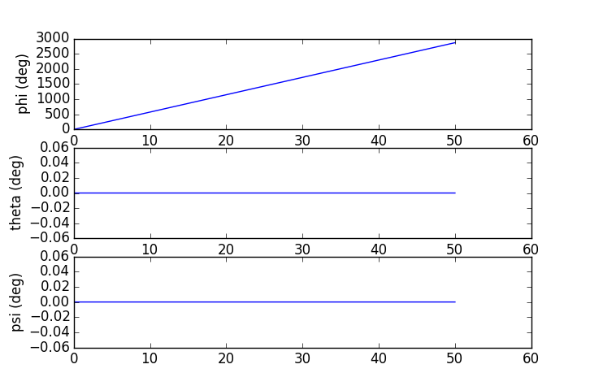
How do we use this with our rigid body equations?
$$J=\left(\begin{matrix}1 & 0 & 0 \\ 0 & 2 & 0 \\ 0 & 0 & 3\end{matrix}\right)$$
(Sorry for different time scales)

Slide 13
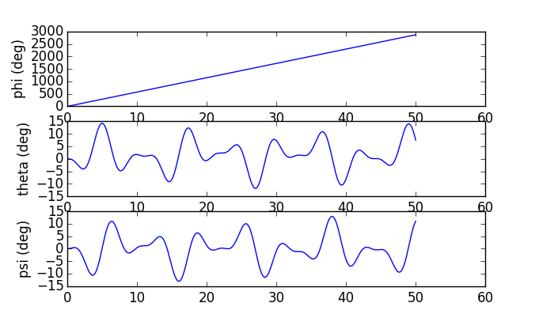
How do we use this with our rigid body equations?
$$J=\left(\begin{matrix}1 & 0.1 & 0 \\ 0.1 & 2 & 0.4 \\ 0 & 0.4 & 3\end{matrix}\right)$$
(Sorry for different time scales)

Slide 14
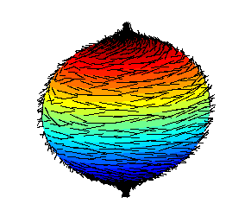
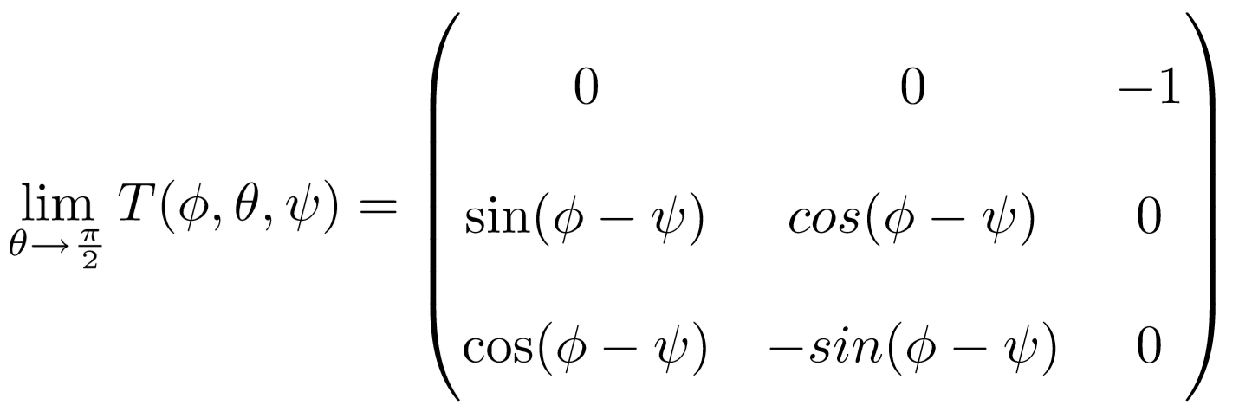
Euler angles – why don’t we use them?
These are very nonlinear
Major problem: Harry Ball Theorem
(Every cow must have at least one cowlick)
(You can’t comb the hair on a coconut)

Slide 15
A: Quaternions or Rotation Matrices!
Q: What do we use instead of Euler Angles?

Slide 16
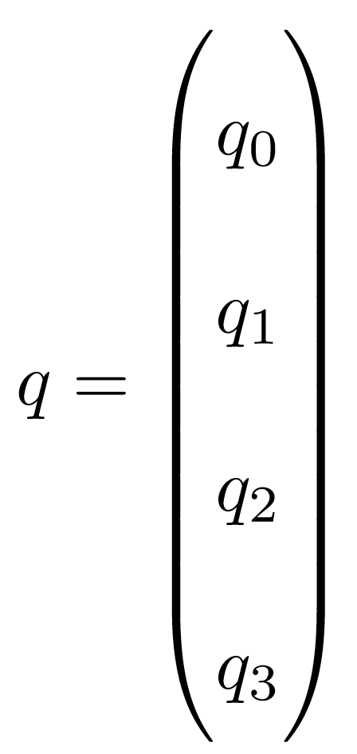
Quaternions in 15 seconds
Very compact and elegant representation of attitude
…which we will not discuss today

Slide 17
Rotation Matrices a.k.a. Direction Cosine Matrices
How to rotate vectors from one frame to another?
$$R=\left(\begin{matrix}r_{11} & r_{12} & r_{13} \\ r_{21} & r_{22} & r_{23} \\ r_{31} & r_{32} & r_{33}\end{matrix}\right)$$
$$\left(\begin{matrix}u_{1} \\ u_{2} \\ u_{3}\end{matrix}\right)=\left(\begin{matrix}r_{11} & r_{12} & r_{13} \\ r_{21} & r_{22} & r_{23} \\ r_{31} & r_{32} & r_{33}\end{matrix}\right)\left(\begin{matrix}v_{1} \\ v_{2} \\ v_{3}\end{matrix}\right)$$
Word to the wise:
Everyone uses different conventions. Stick to one. Always check other people’s convention.
Convention: ${\overset{⃑}{v}}_{b}=R{\overset{⃑}{v}}_{n}$

Slide 18
Rotation Matrices a.k.a. Direction Cosine Matrices
Derivative with respect to ω
$$\left(\begin{matrix}{\dot{r}}_{11} & {\dot{r}}_{12} & {\dot{r}}_{13} \\ {\dot{r}}_{21} & {\dot{r}}_{22} & {\dot{r}}_{23} \\ {\dot{r}}_{31} & {\dot{r}}_{32} & {\dot{r}}_{33}\end{matrix}\right)=\left(\begin{matrix}0 & ω_{z} & {−ω}_{y} \\ {−ω}_{z} & 0 & ω_{x} \\ ω_{y} & {−ω}_{x} & 0\end{matrix}\right)\left(\begin{matrix}r_{11} & r_{12} & r_{13} \\ r_{21} & r_{22} & r_{23} \\ r_{31} & r_{32} & r_{33}\end{matrix}\right)$$

Slide 19
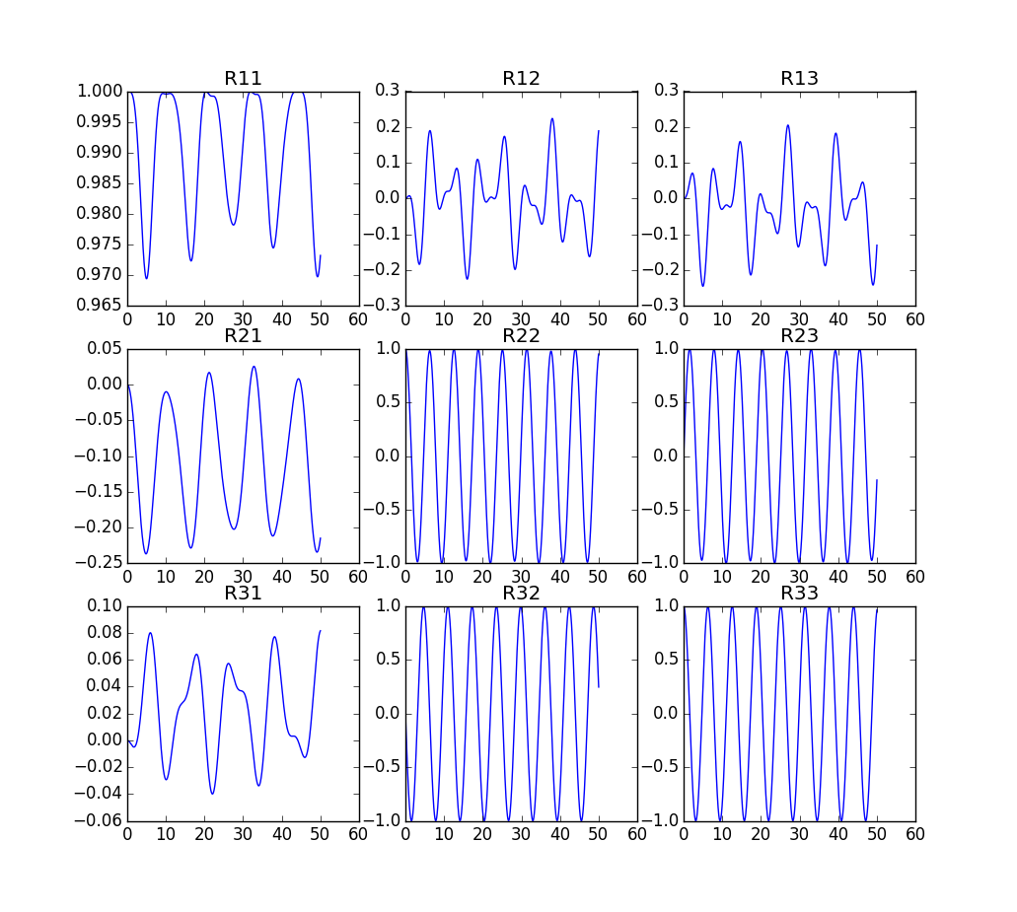
DCM sim
$$J=\left(\begin{matrix}1 & 0.1 & 0 \\ 0.1 & 2 & 0.4 \\ 0 & 0.4 & 3\end{matrix}\right)$$

Slide 20
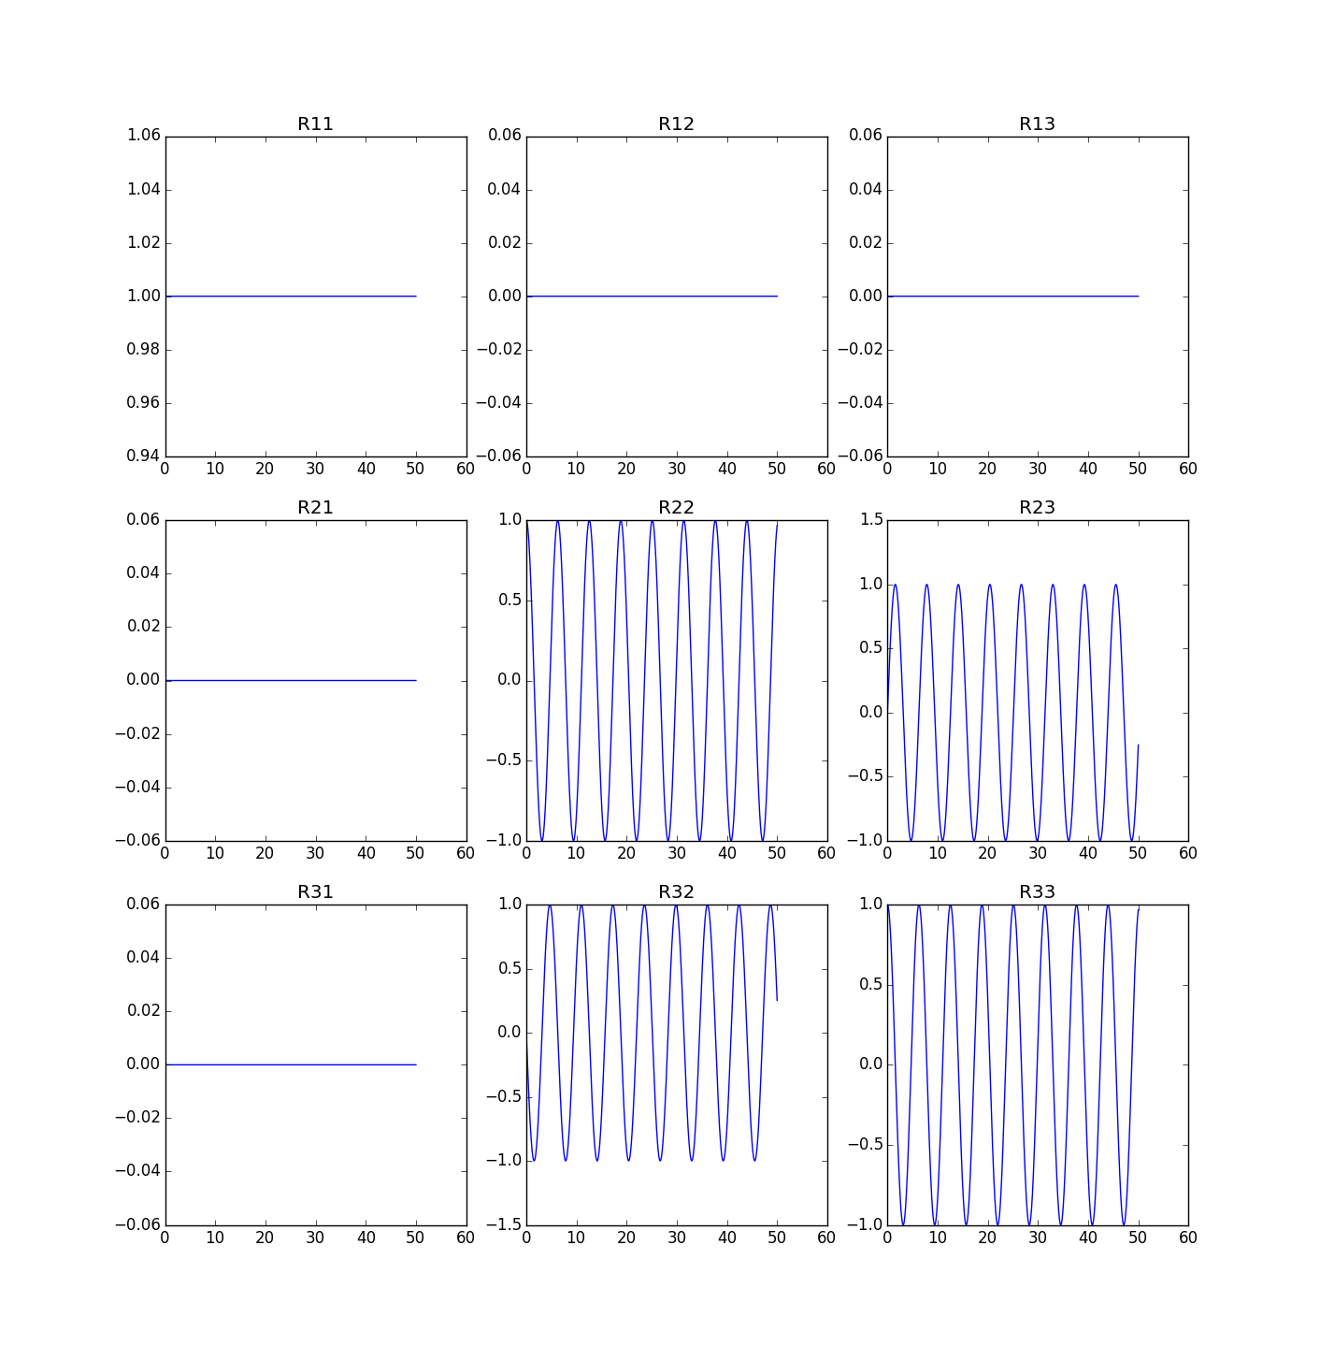
DCM sim
$$J=\left(\begin{matrix}1 & 0 & 0 \\ 0 & 2 & 0 \\ 0 & 0 & 3\end{matrix}\right)$$

Slide 21
What makes DCMs hard?
$$\left(\begin{matrix}r_{11} & r_{12} & r_{13} \\ r_{21} & r_{22} & r_{23} \\ r_{31} & r_{32} & r_{33}\end{matrix}\right)=\left(\begin{matrix}e_{x}^{Τ} \\ e_{y}^{Τ} \\ e_{z}^{Τ}\end{matrix}\right)$$
Hard to visualize
Solution: convert to Euler angles before plotting
$$\begin{matrix}e_{x}^{Τ}e_{x}=1 \\ e_{x}^{Τ}e_{y}=0 \\ e_{y}^{Τ}e_{y}=1\end{matrix}$$
$e_{x}×$ $e_{y}$ - $e_{z}=\left(\begin{matrix}0 \\ 0 \\ 0\end{matrix}\right)$
Must be initialized right-handed and orthonormal
Easiest solution: initialize to identity
Easy solution: initialize as Euler angles then convert to DCM.
If initial angle is free/unknown, use hard solution: enforce orthonormality as a constraint
Only enforce this at one time point!
Doing this more than once destroys LICQ!
$$R_{1}=R_{2}$$
Only enforce these three
$${R_{1}^{Τ}R}_{2}=\left(\begin{matrix}1 & 0 & 0 \\ 0 & 1 & 0 \\ 0 & 0 & 1\end{matrix}\right)$$
Matching conditions have 9 equations and 3 degrees of freedom
Solution: Enforce small relative rotation = 0
IMPORTANT:
Also enforce diagonal elements positive

Slide 22
$$ω\left(0\right)=\left(\begin{matrix}1 \\ 0 \\ 0\end{matrix}\right)$$
$$J=\left(\begin{matrix}1 & 0.1 & 0 \\ 0.1 & 2 & 0.4 \\ 0 & 0.4 & 3\end{matrix}\right)$$
Homework 1:
Reproduce these plots
(Sorry for different time scales)

Slide 23
Homework 2: Match two simulations with different states
$${\overset{⃑}{x}}_{1}=\left(\begin{matrix}{\overset{⃑}{p}}_{n} \\ {\overset{⃑}{v}}_{n} \\ \overset{⃑}{ω} \\ R\end{matrix}\right)$$
$${\overset{⃑}{x}}_{2}=\left(\begin{matrix}{\overset{⃑}{p}}_{n} \\ {\overset{⃑}{v}}_{b} \\ \overset{⃑}{ω} \\ R\end{matrix}\right)$$
$$p\left(0\right)=v\left(0\right)=ω\left(0\right)=\left(\begin{matrix}0 \\ 0 \\ 0\end{matrix}\right)$$
$${\overset{⃑}{F}}_{n}(t)=\left(\begin{matrix}0.3t+0.1 sin{3t} \\ 0.4t+0.2 sin{4t} \\ 0.5t+0.1 sin{5t}\end{matrix}\right)$$
$${\overset{⃑}{T}}_{b}(t)=\left(\begin{matrix}1.5\sin{2t} \\ 2\sin{1t} \\ \sin{0.5t}\end{matrix}\right)$$
$$R(0)=\left(\begin{matrix}1 & 0 & 0 \\ 0 & 1 & 0 \\ 0 & 0 & 1\end{matrix}\right)$$
$$J=\left(\begin{matrix}1 & 0.1 & 0.3 \\ 0.1 & 2 & 0.2 \\ 0.3 & 0.2 & 3\end{matrix}\right)$$

Slide 24
Homework 3: minimum torque satellite de-tumble Multiple shooting with 200 timesteps, rk4 integrator
$$R(0)=\left(\begin{matrix}0.07 & 0.46 & 0.88 \\ −0.89 & −0.37 & 0.26 \\ 0.45 & −0.80 & 0.39\end{matrix}\right)$$
$$ω\left(0\right)=\left(\begin{matrix}2 \\ 1 \\ 4\end{matrix}\right)$$
Objective=$\sum_{k}{{{\overset{⃑}{T}}_{k}}^{Τ}{\overset{⃑}{T}}_{k}}$
$$J=\left(\begin{matrix}1 & 0.1 & 0.3 \\ 0.1 & 2 & 0.2 \\ 0.3 & 0.2 & 3\end{matrix}\right)$$
$$R(6)=\left(\begin{matrix}1 & 0 & 0 \\ 0 & 1 & 0 \\ 0 & 0 & 1\end{matrix}\right)$$
$$ω\left(6\right)=\left(\begin{matrix}0 \\ 0 \\ 0\end{matrix}\right)$$

Slide 25
Homework 4: OPTIONAL BONUS QUESTION same problem as homework 3, but in minimal time
Objective is now end time
$${\left(\begin{matrix}−2 \\ −2 \\ −2\end{matrix}\right)≤\overset{⃑}{T}}_{k}≤\left(\begin{matrix}2 \\ 2 \\ 2\end{matrix}\right)$$
Add bounds on the control:

